Slide 1
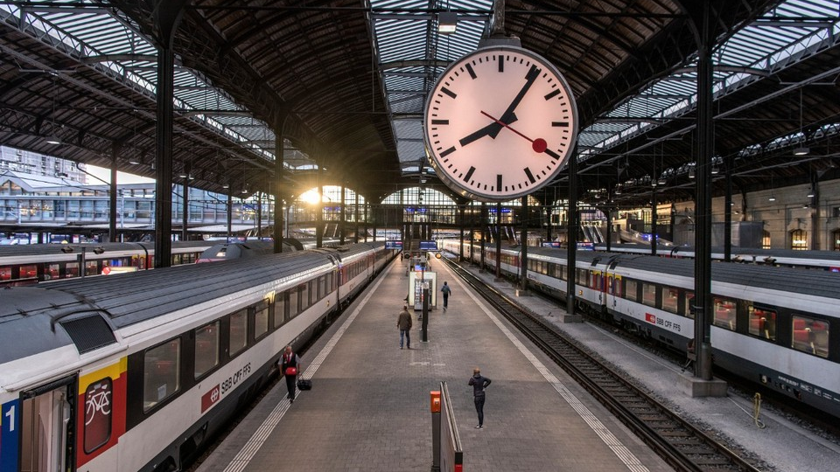
Safe-Station
Cross Railways Detection System

Slide 2





Meet the Team:
Naor Bar Kochva
OpenCV & S3
Netanel Tzadok
HTTP & PubNub
Matan Omesi
Web & Integration
Yaakov Brin
Flask & TinyDB
Omer Hadad
Flask & TinyDB

Slide 3
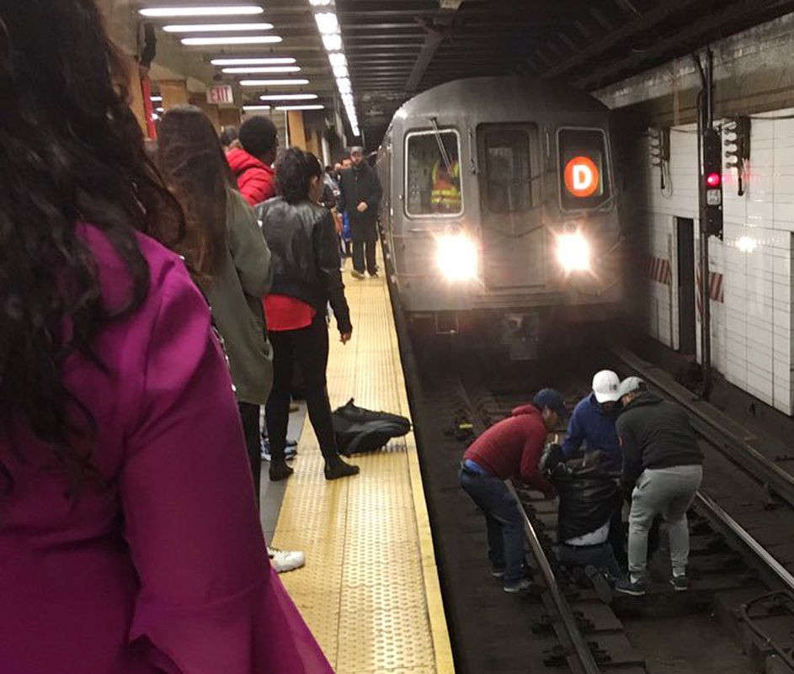
Motivation:
People fall on train tracks, get injured and even die.
Sometimes we do not notice a person when he falls.
There’s a braking distance that doesn’t always prevent death

Slide 4
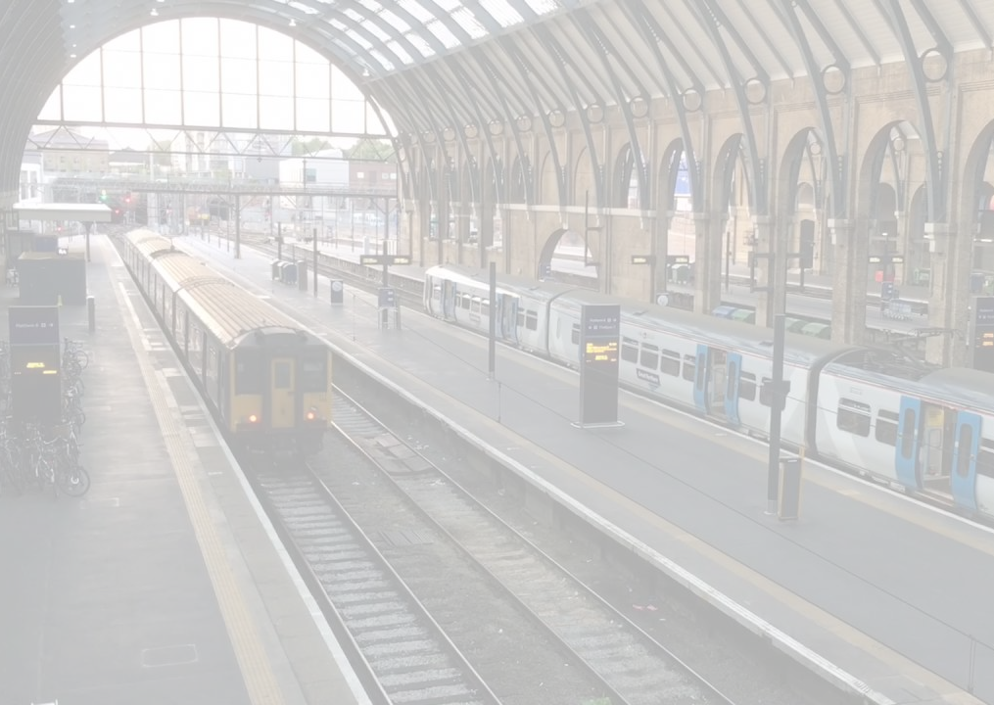
Solution:
Analyze videos from camera’s stations.
Report to station manager and drivers in real time.

Slide 5
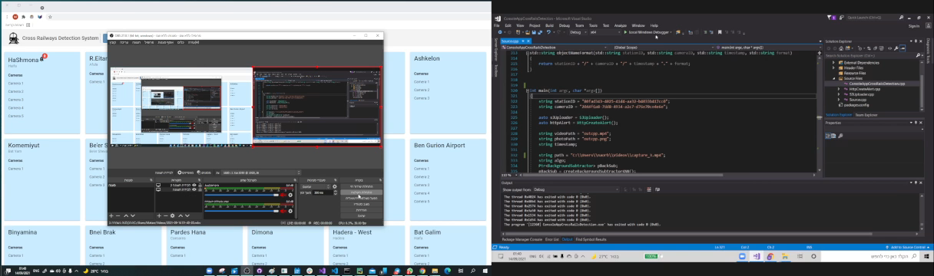
Demo

Slide 6





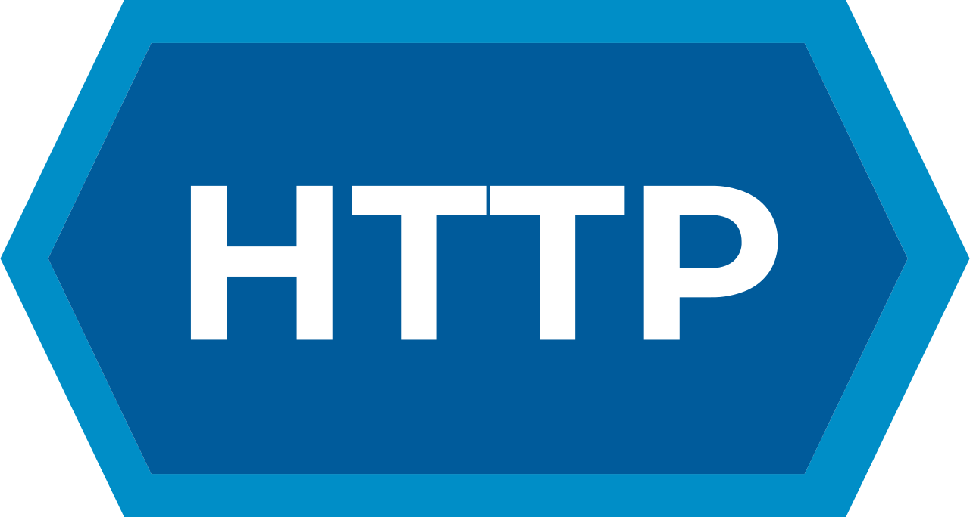



Tech overview:

Slide 7


Tech overview:
Upload to S3
Get from S3

Slide 8
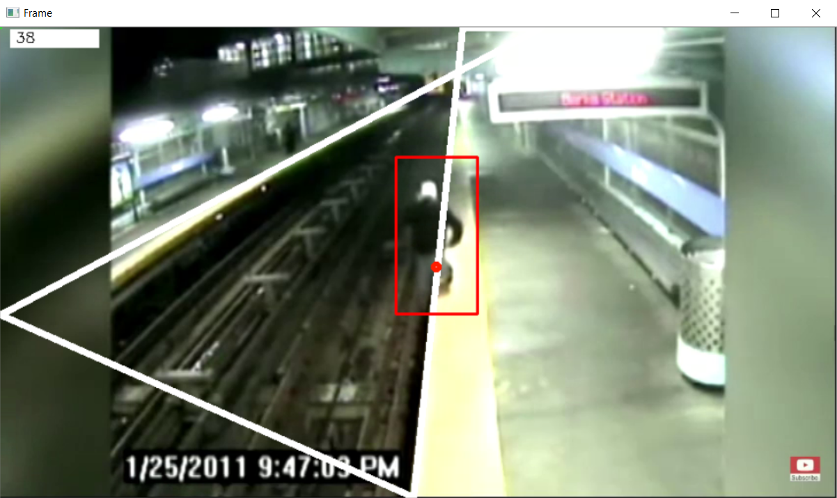
Tech overview:
Image Processing
Detect the yellow lines (forbidden area)
Detect moving objects
Check if any object enter the forbidden area

Slide 9
Tech overview:
Upload to S3
Alert and Upload to cloud
HTTP request to flask server for Realtime Alert
Upload image and video to S3 bucket
HTTP request to flask server for notifying S3 update

Slide 10
Tech overview:
Insert data and Report to UI
Insert alert (station, camera and video id) to database
Send realtime alert to Angular via PubNub service

Slide 11
Tech overview:
Fetching, Listening and Display
Display notification history alerts from TinyDB
Listening to PubNub channel and notify in UI
Display the video and image from S3 bucket
Get from S3

Slide 12
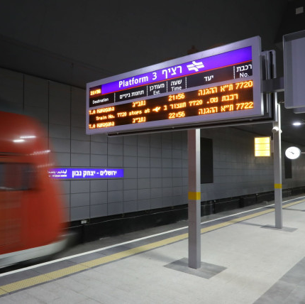
What’s next?
Make static charts for each station and cameras
Report to train drivers designated for those stations
Display in UI what is happening in the cameras which are in the stations in real time

Slide 13
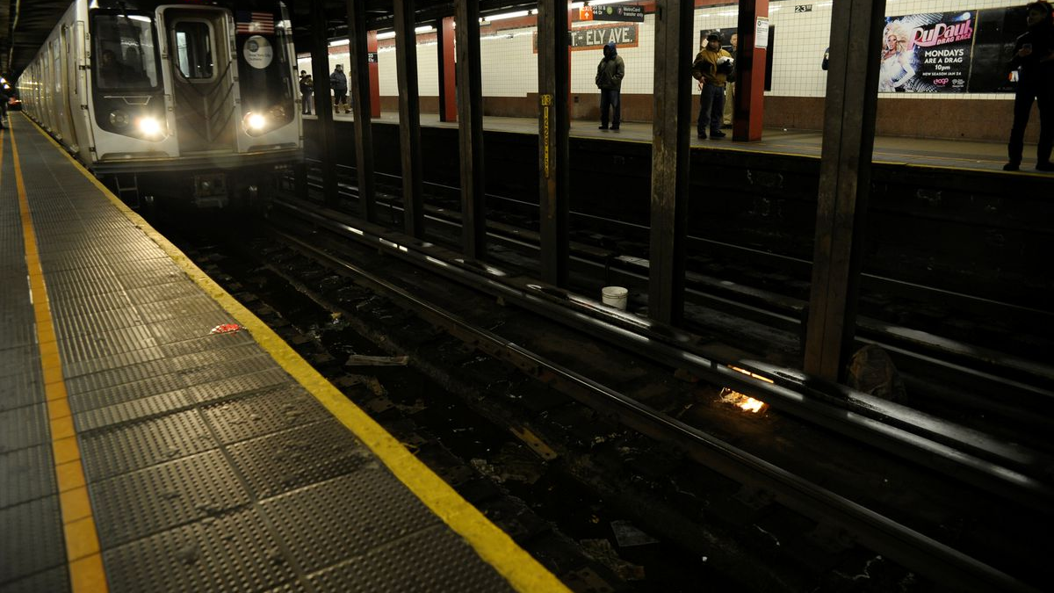
Any Questions?

